Slide 1
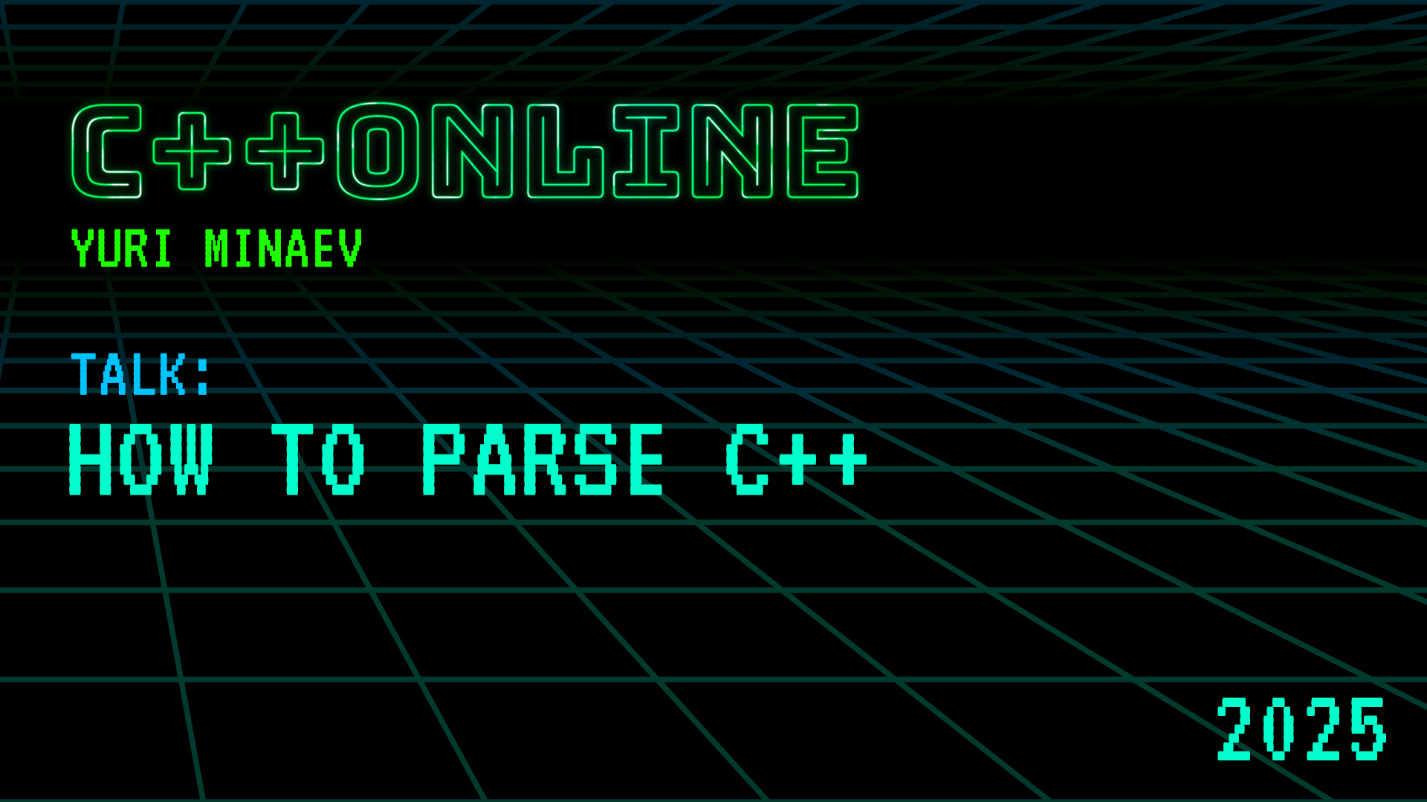

Slide 2


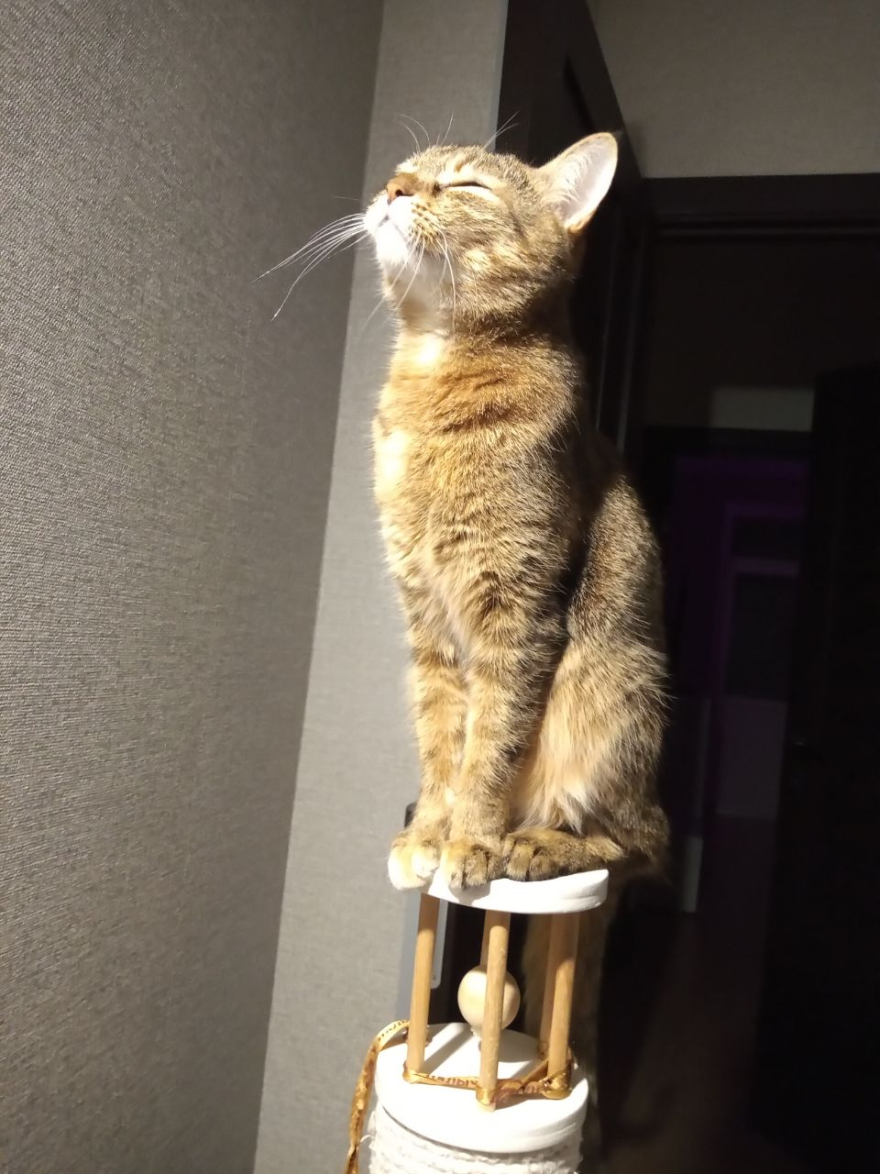
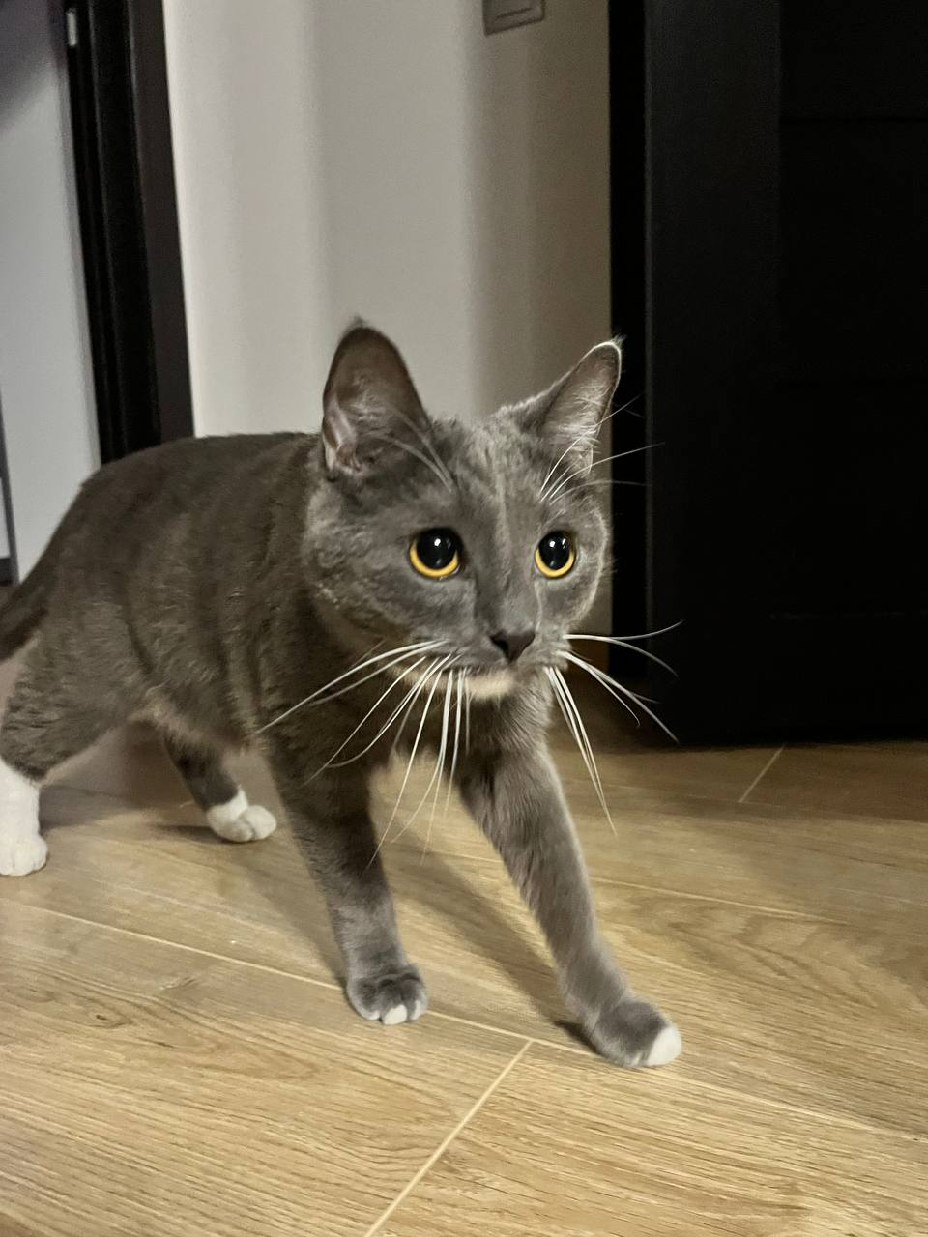
Yuri Minaev
Architect at PVS-Studio

Slide 3
Parsing. What is it about?
minutes = left + seconds * 60
Lexer
<id> <=> <id> <+> <id> <*> <60>
Parser

Slide 4
Parsing. What is it about?
<id> <=> <id> <+> <id> <*> <60>

Slide 5
Parsing. What is it about?
<=>
<id>
<+>
<id>
<*>
<id>
<60>

Slide 6
Parsing. The AST
assign {=}
id {minutes}
binary {+}
id {left}
binary {*}
id {seconds}
num-literal {60}

Slide 7
Grammars

Slide 8
Grammars
The quick brown fox jumps over the lazy dog

Slide 9
Grammars
The quick brown fox jumps over the lazy dog

Slide 10
Grammars
jumps
over
fox
dog
quick
brown
lazy

Slide 11
Grammars
binary {jumps}
attr {over}
id {fox}
id {dog}
attr {quick}
attr {brown}
attr {lazy}

Slide 12
Grammars
Regular
\#([a-fA-F]|[0-9]){3, 6}
Context-free
int a = 42;
Context-sensitive
Bach lang (aabccb, baabcaccb), ...
Ease of use for humans
Ease of parsing for machines

Slide 13
Grammars. Made-up language
expression-list:
binary-expr:
expression
id-expr
expression-list, expression
binary-expr '$' id-expr
expression:
id-expr: one of
binary-expr
a b c d

Slide 14
Grammars. Made-up language
a
a, b, c
b $ c, a $ d
a $ b $ c $ d
expression-list:
expression
expression-list, expression
expression:
binary-expr
binary-expr:
id-expr
binary-expr '$' id-expr
id-expr: one of
a b c d

Slide 15
Parsing

Slide 16
Parsing. Approaches
Descending
Ascending
a $ b $ c

Slide 17
Parsing. Descending
a $ b $ c
expression-list

Slide 18
Parsing. Descending
a $ b $ c
expression-list -> expression

Slide 19
Parsing. Descending
a $ b $ c
expression-list -> expression -> binary-expr

Slide 20
Parsing. Descending
a $ b $ c
expression-list -> expression -> binary-expr -> id-expr

Slide 21
Parsing. Descending
a $ b $ c
expression-list -> expression -> binary-expr -> id-expr -> a

Slide 22
Parsing. Descending
a $ b $ c
id-expr {a}
binary-expr

Slide 23
Parsing. Descending
a $ b $ c
id-expr {a}
binary-expr -> $

Slide 24
Parsing. Descending
a $ b $ c
id-expr {a}
binary-expr -> $ -> id-expr -> b

Slide 25
Parsing. Descending
a $ b $ c
binary-expr {$}
id-expr {a}
id-expr {b}
binary-expr

Slide 26
Parsing. Descending
a $ b $ c
binary-expr {$}
id-expr {a}
id-expr {b}
binary-expr -> $ -> id-expr -> c

Slide 27
Parsing. Descending
a $ b $ c
binary-expr {$}
id-expr {c}
id-expr {a}
id-expr {b}
binary-expr -> $

Slide 28
Parsing. Descending
a $ b $ c
binary-expr {$}
binary-expr {$}
id-expr {c}
id-expr {a}
id-expr {b}

Slide 29
Parsing. Descending
// binary-expr:
// id-expr
// binary-expr '$' id-expr

Slide 30
Parsing. Descending
// binary-expr:
// id-expr
// binary-expr '$' id-expr
ast* binary_expr()
{
}

Slide 31
Parsing. Descending
// binary-expr:
// id-expr
// binary-expr '$' id-expr
ast* binary_expr()
{
auto lhs = id_expr();
return lhs;
}

Slide 32
Parsing. Descending
// binary-expr:
// id-expr
// binary-expr '$' id-expr
ast* binary_expr()
{
auto lhs = id_expr();
while(match('$'))
{
auto op = consume();
auto rhs = id_expr();
lhs = make_binary(lhs, op, rhs);
}
return lhs;
}

Slide 33
Parsing. Descending
// binary-expr:
// id-expr
// binary-expr '$' id-expr
ast* binary_expr()
{
auto lhs = id_expr();
while(match('$'))
{
auto op = consume();
auto rhs = id_expr();
lhs = make_binary(lhs, op, rhs);
}
return lhs;
}

Slide 34
Parsing. Descending
// binary-expr:
// id-expr
// binary-expr '$' id-expr ???
ast* binary_expr()
{
auto lhs = id_expr();
while(match('$'))
{
auto op = consume();
auto rhs = id_expr();
lhs = make_binary(lhs, op, rhs);
}
return lhs;
}

Slide 35
Recursive descend tenet 1: Thou shalt not left-recurse

Slide 36
Parsing. Ascending
a $ b $ c
binary-expr:
id-expr
binary-expr '$' id-expr
id-expr: one of
a b c d

Slide 37
Parsing. Ascending
$ b $ c
a
binary-expr:
id-expr
binary-expr '$' id-expr
id-expr: one of
a b c d

Slide 38
Parsing. Ascending
$ b $ c
id-expr {a}
binary-expr:
id-expr
binary-expr '$' id-expr
id-expr: one of
a b c d

Slide 39
Parsing. Ascending
$ b $ c
binary-expr {a}
binary-expr:
id-expr
binary-expr '$' id-expr
id-expr: one of
a b c d

Slide 40
Parsing. Ascending
b $ c
$
binary-expr {a}
binary-expr:
id-expr
binary-expr '$' id-expr
id-expr: one of
a b c d

Slide 41
Parsing. Ascending
$ c
id-expr {b}
$
binary-expr:
id-expr
binary-expr '$' id-expr
id-expr: one of
a b c d
binary-expr {a}

Slide 42
Parsing. Ascending
$ c
id-expr {b}
$
binary-expr:
id-expr
binary-expr '$' id-expr
id-expr: one of
a b c d
binary-expr {a}

Slide 43
Parsing. Ascending
$ c
binary-expr {$}
binary-expr:
id-expr
binary-expr '$' id-expr
id-expr: one of
a b c d

Slide 44
Parsing. Ascending
c
$
binary-expr {$}
binary-expr:
id-expr
binary-expr '$' id-expr
id-expr: one of
a b c d

Slide 45
Parsing. Ascending
id-expr {c}
$
binary-expr:
id-expr
binary-expr '$' id-expr
id-expr: one of
a b c d
binary-expr {$}

Slide 46
Parsing. Ascending
binary-expr {$}
binary-expr:
id-expr
binary-expr '$' id-expr
id-expr: one of
a b c d

Slide 47


Slide 48
C++ Grammar
Index | Summary | [gram]
A.1 | General | [gram.general]
A.2 | Keywords | [gram.key]
A.3 | Lexical conventions | [gram.lex]
A.4 | Basis | [gram.basis]
A.5 | Expressions | [gram.expr]
A.6 | Statements | [gram.stmt]
A.7 | Declarations | [gam.dcl]
A.8 | Modules | [gram.module]
A.9 | Classes | [gram.class]
A.10 | Overloading | [gram.over]
A.11 | Templates | [gram.temp]
A.12 | Exceptions handling | [gram.except]
A.13 | Preprocessing directives | [gram.cpp]

Slide 49
Getting On With It
// binary-expr:
// id-expr
// binary-expr '$' id-expr
ast* binary_expr()
{
auto lhs = id_expr();
while(match('$'))
{
auto op = consume();
auto rhs = id_expr();
lhs = make_binary(lhs, op, rhs);
}
return lhs;
}

Slide 50
Getting On With It
// additive-expression:
// multiplicative-expression
// additive-expression + multiplicative-expression
// additive-expression - multiplicative-expression
ast::expr* add_expr()
{
auto lhs = mul_expr();
while(match('+', '-'))
{
auto op = consume();
auto rhs = mul_expr();
lhs = ast::make_binary(lhs, op, rhs);
}
return lhs;
}

Slide 51
I HAZ EXPRESHUNZ
int meow()
{
return 1 + []()
{
}();
}

Slide 52
I HAZ EXPRESHUNZ
int meow()
{
return 1 + []()
{
struct oopsy
{
};
}();
}

Slide 53
I HAZ EXPRESHUNZ
int meow()
{
return 1 + []()
{
struct oopsy
{
int operator()()
{
return 42;
}
};
}();
}

Slide 54
I HAZ EXPRESHUNZ
int meow()
{
return 1 + []()
{
struct oopsy
{
int operator()()
{
return 42;
}
};
oopsy o1;
oopsy o2;
}();
}

Slide 55
I HAZ EXPRESHUNZ
int meow()
{
return 1 + []()
{
struct oopsy
{
int operator()()
{
return 42;
}
};
oopsy o1;
oopsy o2;
return o1() + o2();
}();
}

Slide 56
I HAZ EXPRESHUNZ
primary-expression:
literal
this
( expression )
id-expression
lambda-expression
fold-expression
requires-expression

Slide 57
I HAZ EXPRESHUNZ
primary-expression:
literal
this
( expression )
id-expression
lambda-expression
fold-expression
requires-expression
lambda-expression:
lambda-introducer attribute-specifier-seq' lambda-declarator compound-statement
lambda-introducer < template-parameter-list > requires-clause' attribute-specifier-seq'
lambda-declarator compound-statement

Slide 58
I HAZ EXPRESHUNZ
primary-expression:
literal
this
( expression )
id-expression
lambda-expression
fold-expression
requires-expression
lambda-expression:
lambda-introducer attribute-specifier-seq' lambda-declarator compound-statement
lambda-introducer < template-parameter-list > requires-clause' attribute-specifier-seq'
lambda-declarator compound-statement

Slide 59
I HAZ EXPRESHUNZ
primary-expression:
literal
this
( expression )
id-expression
lambda-expression
fold-expression
requires-expression
lambda-expression:
lambda-introducer attribute-specifier-seq' lambda-declarator compound-statement
lambda-introducer < template-parameter-list > requires-clause' attribute-specifier-seq'
lambda-declarator compound-statement

Slide 60
I HAZ EXPRESHUNZ
statement:
labeled-statement
attribute-specifier-seq' expression-statement
attribute-specifier-seq' compound-statement
attribute-specifier-seq' selection-statement
attribute-specifier-seq' iteration-statement
attribute-specifier-seq' jump-statement
attribute-specifier-seq' try-block
declaration-statement

Slide 61
Declarations
int meow(int);
int meow(2);

Slide 62
Declarations
int meow(2);

Slide 63
Declarations
. int meow(2);
declaration:
.name-declaration
special-declaration

Slide 64
Declarations
. int meow(2);
name-declaration:
.block-declaration
nodeclspec-function-declaration
function-definition
deduction-guide
empty-declaration

Slide 65
Declarations
. int meow(2);
block-declaration:
.simple-declaration
That's a lie

Slide 66
Declarations
. int meow(2);
simple-declaration:
.decl-specifier-seq init-declarator-list' ;
attribute-specifier-seq decl-specifier-seq init-declarator-list ;
attribute-specifier-seq' decl-specifier-seq ref-qualifier' [ identifier-list ] initializer ;

Slide 67
Declarations
int . meow(2);
decl-specifier-seq -> ... -> simple-type-specifier -> int

Slide 68
Declarations
int . meow(2);
simple-declaration:
decl-specifier-seq .init-declarator-list' ;

Slide 69
Declarations
int . meow(2);
init-declarator-list:
.init-declarator
init-declarator-list, init-declarator

Slide 70
Declarations
int . meow(2);
init-declarator:
.declarator initializer'

Slide 71
Declarations
int . meow(2);
declarator:
ptr-declarator
.noptr-declarator parameters-and-qualifiers

Slide 72
Declarations
int . meow(2);
noptr-declarator -> declarator-id -> ... -> id-expression ->
unqualified-id -> meow

Slide 73
Declarations
int meow . (2);
declarator:
ptr-declarator
noptr-declarator .parameters-and-qualifiers

Slide 74
Declarations
int meow . (2);
parameters-and-qualifiers:
.( parameter-declaration-clause ) cv-qualifier-seq'
ref-qualifier' noexcept-specifier' attribute-specifier-seq'

Slide 75
Declarations
int meow (. 2);
parameters-and-qualifiers:
( .parameter-declaration-clause ) cv-qualifier-seq'
ref-qualifier' noexcept-specifier' attribute-specifier-seq'
SyntaxError

Slide 76
Declarations
int meow(int);
int meow(2);

Slide 77
Declarations
int meow(int);
decl-specifier-seq declarator-id (parameter-declaration-clause);
int meow(2);
decl-specifier-seq declarator-id (expression-list);

Slide 78
Declarations
int meow(int);
decl-specifier-seq declarator-id (parameter-declaration-clause);
int meow(2);
decl-specifier-seq declarator-id (expression-list);

Slide 79
Recursive descend tenet 1: Thou shalt not left-recurse

Slide 80
Recursive descend tenet 1: Thou shalt not left-recurse
Recursive descend tenet 2: No prefix shall overlap with another

Slide 81
The Most Vexing Of Parses
struct paws{};
struct cat{ cat(...); };
void meow()
{
}

Slide 82
The Most Vexing Of Parses
struct paws{};
struct cat{ cat(...); };
void meow()
{
cat kitty0 (paws);
cat kitty1 (paws());
}

Slide 83
The Most Vexing Of Parses
struct paws{};
struct cat{ cat(...); };
void meow()
{
cat kitty0 (paws); // cat(paws)
cat kitty1 (paws()); // cat(paws(void))
}

Slide 84
The Most Vexing Of Parses
struct paws{};
struct cat{ cat(...); };
void meow()
{
cat kitty0 (paws); // cat(paws)
cat kitty1 (paws()); // cat(paws(void))
cat kitty2 ((paws()));
}

Slide 85
The Most Vexing Of Parses
struct paws{};
struct cat{ cat(...); };
void meow()
{
cat kitty0 (paws); // cat(paws)
cat kitty1 (paws()); // cat(paws(void))
cat kitty2 ((paws())); // cat ctor called from temp paws
}

Slide 86
The Most Vexing Of Parses
struct paws{};
struct cat{ cat(...); };
void meow()
{
cat kitty0 (paws); // cat(paws)
cat kitty1 (paws()); // cat(paws(void))
cat kitty2 ((paws())); // cat ctor called from temp paws
cat kitty3 (paws(), paws(), paws(), paws()); // function
cat kitty4 (paws(), paws(), paws(), (paws())); // variable
}

Slide 87
The Most Vexing Of Parses
cat kitty3 (paws(), paws(), paws(), paws()); // function
cat kitty4 (paws(), paws(), paws(), (paws())); // variable
Ambiguous
Disambiguation

Slide 88
Recursive descend tenet 1: Thou shalt not left-recurse
Recursive descend tenet 2: No prefix shall overlap with another

Slide 89
Recursive descend tenet 2: No prefix shall overlap with another*
* Lest backtracking shall occur

Slide 90
Back We Go
int meow (. 2);
parameters-and-qualifiers:
( .parameter-declaration-clause ) cv-qualifier-seq'
ref-qualifier' noexcept-specifier' attribute-specifier-seq'

Slide 91
Back We Go
int meow .(2);

Slide 92
Back We Go
int meow .(2);
init-declarator:
declarator .initializer'

Slide 93
Back We Go
int meow .(2);
initializer:
.brace-or-equal-initializer
( expression-list )

Slide 94
Back We Go
int meow .(2);
initializer:
brace-or-equal-initializer
.( expression-list )

Slide 95
Back We Go
int meow (. 2);
initializer:
brace-or-equal-initializer
(.expression-list )

Slide 96
Back We Go
int meow (2 .);
initializer:
brace-or-equal-initializer
(expression-list .)

Slide 97
Back We Go
int meow (2) .;
initializer:
brace-or-equal-initializer
(expression-list).

Slide 98
Recursive descend tenet 2: No prefix shall overlap with another*
* Lest backtracking should occur**

Slide 99
Recursive descend tenet 2: No prefix shall overlap with another*
* Lest backtracking should occur**
** Backtacks lead to exponential complexity

Slide 100
Exponent
class no_mem_pool{};
template <size_t SIZE, class OTHER>
class mem_pool_list
{
public:
mem_pool_list() {}
};

Slide 101
Exponent
typedef class
mem_pool_list< 16,
mem_pool_list< 32,
mem_pool_list< 64,
...
mem_pool_list< 512,
mem_pool_list< 1024,
mem_pool_list< 2048, no_mem_pool
>>> ... >>> pools_t;

Slide 102
Exponent
typedef class
mem_pool_list< 16,
mem_pool_list< 32,
mem_pool_list< 64,
mem_pool_list< 512,
mem_pool_list< 1024,
mem_pool_list< 2048, no_mem_pool >
>
>
>
>
> pools_t;

Slide 103
Exponent
typedef class
mp< 16,
mp< 32,
mp< 64,
mp< 512,
mp< 1024,
mp< 2048, nmp >
>
>
>
>
> pools_t;
simple-type-specifier:
nested-name-specifier' type-name
nested-name-specifier' simple-template-id
nested-name-specifier' template-name
nested-name-specifier:
type-name ::
namespace-name ::
simple-template-id ::

Slide 104
Exponent
typedef class
mp< 16,
mp< 32,
mp< 64,
mp< 512,
mp< 1024,
mp< 2048, nmp >
>
>
>
>
> pools_t;
simple-type-specifier:
nested-name-specifier' type-name
nested-name-specifier' simple-template-id
nested-name-specifier' template-name
nested-name-specifier:
type-name ::
namespace-name ::
simple-template-id ::

Slide 105
Exponent
typedef class
mp< 16,
mp< 32,
mp< 64,
mp< 512,
mp< 1024,
mp< 2048, nmp >
>
>
>
>
> pools_t;
simple-type-specifier:
nested-name-specifier' type-name
nested-name-specifier' simple-template-id
nested-name-specifier' template-name
nested-name-specifier:
type-name ::
namespace-name ::
simple-template-id ::

Slide 106
Exponent
typedef class
mp< 16,
mp< 32,
mp< 64,
mp< 512,
mp< 1024,
mp< 2048, nmp >
>
>
>
>
> pools_t;
simple-type-specifier:
nested-name-specifier' type-name
nested-name-specifier' simple-template-id
nested-name-specifier' template-name
nested-name-specifier:
type-name ::
namespace-name ::
simple-template-id ::

Slide 107
Exponent
typedef class
mp< 16,
mp< 32,
mp< 64,
mp< 512,
mp< 1024,
mp< 2048, nmp >
>
>
>
>
> pools_t;
simple-type-specifier:
nested-name-specifier' type-name
nested-name-specifier' simple-template-id
nested-name-specifier' template-name
nested-name-specifier:
type-name ::
namespace-name ::
simple-template-id ::

Slide 108
Exponent
typedef class
mp< 16,
mp< 32,
mp< 64,
mp< 512,
mp< 1024,
mp< 2048, nmp >
>
>
>
>
> pools_t;
simple-type-specifier:
nested-name-specifier' type-name
nested-name-specifier' simple-template-id
nested-name-specifier' template-name
nested-name-specifier:
type-name ::
namespace-name ::
simple-template-id ::

Slide 109
Exponent
typedef class
mp< 16,
mp< 32,
mp< 64,
mp< 512,
mp< 1024,
mp< 2048, nmp >
>
>
>
>
> pools_t;
simple-type-specifier:
nested-name-specifier' type-name
nested-name-specifier' simple-template-id
nested-name-specifier' template-name
nested-name-specifier:
type-name ::
namespace-name ::
simple-template-id ::

Slide 110
Exponent
typedef class
mp< 16,
mp< 32,
mp< 64,
mp< 512,
mp< 1024,
mp< 2048, nmp >
>
>
>
>
> pools_t;
simple-type-specifier:
nested-name-specifier' type-name
nested-name-specifier' simple-template-id
nested-name-specifier' template-name
nested-name-specifier:
type-name ::
namespace-name ::
simple-template-id ::

Slide 111
Exponent
typedef class
mp< 16,
mp< 32,
mp< 64,
mp< 512,
mp< 1024,
mp< 2048, nmp >
>
>
>
>
> pools_t;
simple-type-specifier:
nested-name-specifier' type-name
nested-name-specifier' simple-template-id
nested-name-specifier' template-name
nested-name-specifier:
type-name ::
namespace-name ::
simple-template-id ::

Slide 112
Exponent
typedef class
mp< 16,
mp< 32,
mp< 64,
mp< 512,
mp< 1024,
mp< 2048, nmp >
>
>
>
>
> pools_t;
simple-type-specifier:
nested-name-specifier' type-name
nested-name-specifier' simple-template-id
nested-name-specifier' template-name
nested-name-specifier:
type-name ::
namespace-name ::
simple-template-id ::

Slide 113
Exponent
typedef class
mp< 16,
mp< 32,
mp< 64,
mp< 512,
mp< 1024,
mp< 2048, nmp >
>
>
>
>
> pools_t;
simple-type-specifier:
nested-name-specifier' type-name
nested-name-specifier' simple-template-id
nested-name-specifier' template-name
nested-name-specifier:
type-name ::
namespace-name ::
simple-template-id ::

Slide 114
Exponent
typedef class
mp< 16,
mp< 32,
mp< 64,
mp< 512,
mp< 1024,
mp< 2048, nmp >
>
>
>
>
> pools_t;
simple-type-specifier:
nested-name-specifier' type-name
nested-name-specifier' simple-template-id
nested-name-specifier' template-name
nested-name-specifier:
type-name ::
namespace-name ::
simple-template-id ::

Slide 115
Exponent
typedef class
mp< 16,
mp< 32,
mp< 64,
mp< 512,
mp< 1024,
mp< 2048, nmp >
>
>
>
>
> pools_t;
simple-type-specifier:
nested-name-specifier' type-name
nested-name-specifier' simple-template-id
nested-name-specifier' template-name
nested-name-specifier:
type-name ::
namespace-name ::
simple-template-id ::

Slide 116
Exponent
typedef class
mp< 16,
mp< 32,
mp< 64,
mp< 512,
mp< 1024,
mp< 2048, nmp >
>
>
>
>
> pools_t;
simple-type-specifier:
nested-name-specifier' type-name
nested-name-specifier' simple-template-id
nested-name-specifier' template-name
nested-name-specifier:
type-name ::
namespace-name ::
simple-template-id ::

Slide 117
Made-up language again
expression-list:
binary-expr:
expression
id-expr
expression-list, expression
binary-expr '$' id-expr
expression:
id-expr: one of
binary-expr
a b c d
joker-expr
joker-expr:
binary-expr '$' 'X'

Slide 118
Made-up language again
a
a, b, c
b $ c, a $ d
a $ b $ c $ d
a $ X
a $ b $ X
expression-list:
expression
expression-list, expression
expression:
binary-expr
joker-expr
joker-expr:
binary-expr '$' 'X'
binary-expr:
id-expr
binary-expr '$' id-expr
id-expr: one of
a b c d

Slide 119
Made-up language again
a
a, b, c
b $ c, a $ d
a $ b $ c $ d
a $ X
a $ b $ X
expression-list:
expression
expression-list, expression
expression:
binary-expr
joker-expr
joker-expr:
binary-expr '$' 'X'
binary-expr:
id-expr
binary-expr '$' id-expr
id-expr: one of
a b c d

Slide 120
Made-up language again
a $ b $ X
lexer_pos: 0

Slide 121
Made-up language again
a $ b $ X
lexer_pos: 1
expression-list -> expression -> binary-expr -> id-expr -> a

Slide 122
Made-up language again
a $ b $ X
lexer_pos: 1
id-expr {a}

Slide 123
Made-up language again
a $ b $ X
lexer_pos: 3
binary-expr {$}
id-expr {a}
id-expr {b}
binary-expr -> $

Slide 124
Made-up language again
a $ b $ X
lexer_pos: 3
binary-expr{$}, 3
binary-expr {$}
id-expr {a}
id-expr {b}

Slide 125
Made-up language again
a $ b $ X
lexer_pos: 4
binary-expr{$}, 3
binary-expr {$}
id-expr {a}
id-expr {b}

Slide 126
Made-up language again
a $ b $ X
lexer_pos: 4
binary-expr{$}, 3
binary-expr {$}
id-expr {a}
id-expr {b}

Slide 127
Made-up language again
a $ b $ X
lexer_pos: 0
binary-expr{$}, 3
binary-expr {$}
id-expr {a}
id-expr {b}

Slide 128
Made-up language again
a $ b $ X
lexer_pos: 0
binary-expr{$}, 3
binary-expr {$}
id-expr {a}
id-expr {b}
expression-list -> expression -> joker-expr ->binary-expr

Slide 129
Made-up language again
a $ b $ X
lexer_pos: 0
binary-expr{$}, 3
binary-expr {$}
id-expr {a}
id-expr {b}
expression-list -> expression -> joker-expr -> binary-expr

Slide 130
Made-up language again
a $ b $ X
lexer_pos: 3
binary-expr {$}
id-expr {a}
id-expr {b}
expression-list -> expression -> joker-expr -> binary-expr

Slide 131
Made-up language again
a $ b $ X
lexer_pos: 4
binary-expr {$}
id-expr {a}
id-expr {b}
expression-list -> expression -> joker-expr

Slide 132
Made-up language again
a $ b $ X
lexer_pos: 5
joker-expr
binary-expr {$}
id-expr {a}
id-expr {b}

Slide 133
Exponent Defeated
typedef class
mp< 16,
mp< 32,
mp< 64,
mp< 512,
mp< 1024,
mp< 2048, nmp >
>
>
>
>
> pools_t;
simple-type-specifier:
nested-name-specifier' type-name
nested-name-specifier' simple-template-id
nested-name-specifier' template-name
nested-name-specifier:
type-name ::
namespace-name ::
simple-template-id ::

Slide 134
Exponent Defeated
typedef class
mp< 16,
mp< 32,
mp< 64,
mp< 512,
mp< 1024,
mp< 2048, nmp >
>
>
>
>
> pools_t;
simple-type-specifier:
nested-name-specifier' type-name
nested-name-specifier' simple-template-id
nested-name-specifier' template-name
nested-name-specifier:
type-name ::
namespace-name ::
simple-template-id ::

Slide 135
Exponent Defeated
typedef class
mp< 16,
mp< 32,
mp< 64,
mp< 512,
mp< 1024,
simple-template-id
>
>
>
>
> pools_t;
simple-type-specifier:
nested-name-specifier' type-name
nested-name-specifier' simple-template-id
nested-name-specifier' template-name
nested-name-specifier:
type-name ::
namespace-name ::
simple-template-id ::

Slide 136
Exponent Defeated
typedef class
mp< 16,
mp< 32,
mp< 64,
mp< 512,
simple-template-id
>
>
>
> pools_t;
simple-type-specifier:
nested-name-specifier' type-name
nested-name-specifier' simple-template-id
nested-name-specifier' template-name
nested-name-specifier:
type-name ::
namespace-name ::
simple-template-id ::

Slide 137
Exponent Defeated
typedef class
mp< 16,
simple-template-id
> pools_t;
simple-type-specifier:
nested-name-specifier' type-name
nested-name-specifier' simple-template-id
nested-name-specifier' template-name
nested-name-specifier:
type-name ::
namespace-name ::
simple-template-id ::

Slide 138
Exponent Defeated
typedef class
simple-template-id pools_t;
simple-type-specifier:
nested-name-specifier' type-name
nested-name-specifier' simple-template-id
nested-name-specifier' template-name
nested-name-specifier:
type-name ::
namespace-name ::
simple-template-id ::

Slide 139
Exponent Defeated
typedef class
simple-template-id pools_t;
simple-type-specifier:
nested-name-specifier' type-name
nested-name-specifier' simple-template-id
nested-name-specifier' template-name
nested-name-specifier:
type-name ::
namespace-name ::
simple-template-id ::

Slide 140
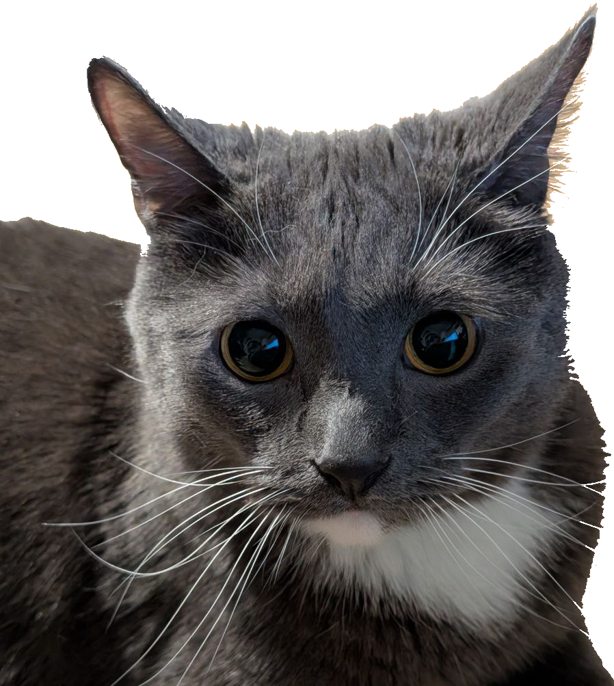
Questions

